Slide 1
UNIT - VI
Introduction to Full Stack Web Development and UI/UX

Slide 2
Syllabus
Introduction to Web Development,
User Interface Design, frontend, backend, databases,
CRUD applications,
Languages such as HTML, CSS, PHP, Java Scripts, and frameworks, by using VS code tool,
Single page applications (SPA),
Responsive web design, mobile-first development,
Job-roles and skillset for full stack and UI/UX

Slide 3
Introduction to Web Development
Web development refers to the creating, building, and maintaining of websites.
It includes aspects such as web design, web publishing, web programming, and database management.
It is the creation of an application that works over the internet i.e. websites.
The word Web Development is made up of two words, that is:
Web: It refers to websites, web pages or anything that works over the internet.
Development: It refers to building the application from scratch.
Web Development can be classified into three ways:
Frontend Development
Backend Development
FullStack Development
Let us discuss them in detail.

Slide 4
UI Design
UI stands for user interface.
User interface (UI) design is likely the first thing you encounter when you use an application or visit a website.
Anything you interact with as a user is part of the user interface.
User interface design is responsible for a product's appearance, interactivity, usability, behaviour, and overall feel.
UI design can determine whether a user has a positive experience with a product, so it's essential for companies and creators to familiarise themselves with UI design best practices.

Slide 5
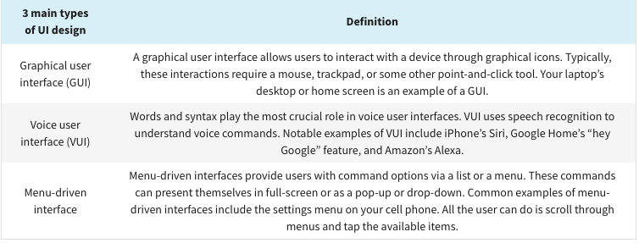
3 Types of User Interface Design
Many different types of UI design exist. The chart below compiles a few of the most popular and well-known.

Slide 6
UI Design
Additional types of UI design include touchscreen user interface and form-based user interface.
Touchscreen user interfaces are GUIs that use touchscreen technology to let you swipe or click rather than needing to use a mouse or stylus.
Form-based user interfaces use text boxes, checkboxes, and other informational components.
They enable users to fill out electronic forms.
Key principles of UI design
An easy way to recall the fundamental principles of UI design is to learn the four c’s:
Control: The users should be in control of the interface.
Consistency: Use common elements to make your UI predictable and easy to navigate, even for novice users.
Comfortability: Interacting with a product should be an effortless, comfortable experience.
Cognitive load: It’s critical to be mindful of bombarding users with content. Be as clear and concise as possible.

Slide 7
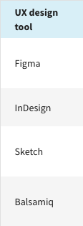
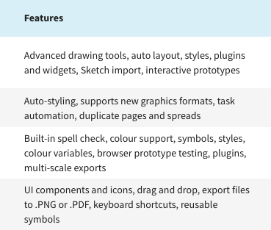
UI Design Tools
It is essential to have the right tools and technology to support your UI design efforts.
Various UI design tools and its features are listed below :

Slide 8
UX Design
UX means User Experience
User experience (UX) focuses on having a deep understanding of users, what they need, what they value, their abilities, and also their limitations.
It also takes into account the business goals and objectives of the group managing the project.
UX best practices promote improving the quality of the user’s interaction with and perceptions of your product and any related services.
User experience (UX) design is the process design teams use to create products that provide meaningful and relevant experiences to users.
UX design involves the design of the entire process of acquiring and integrating the product, including aspects of branding, design, usability and function.

Slide 9
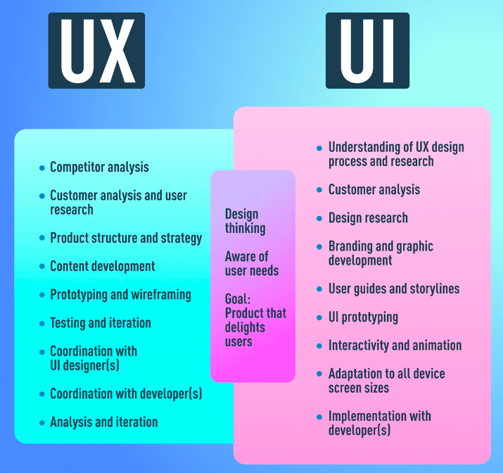
UX vs UI: What’s the Difference?

Slide 10
Frontend Development
The part of a website where the user interacts directly is termed as front end.
It is the visible part of website or web application which is responsible for user experience. It is also referred to as the ‘client side’ of the application.
Front-end developers use HTML, CSS, JavaScript, and their relevant frameworks to ensure that content is presented effectively and that users have an excellent experience.
Popular Frontend Technologies
HTML: HTML stands for HyperText Markup Language. It is used to design the front end portion of web pages using markup language. It acts as a skeleton for a website since it is used to make the structure of a website.
CSS: Cascading Style Sheets fondly referred to as CSS is a simply designed language intended to simplify the process of making web pages presentable. It is used to style our website.
JavaScript: JavaScript is a scripting language used to provide a dynamic behavior to our website.

Slide 11
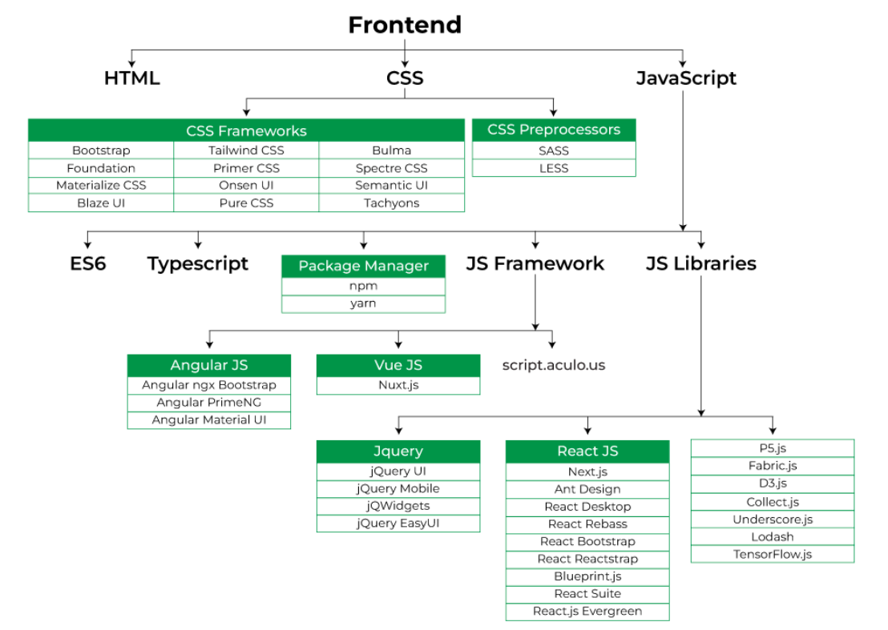
Front End Development

Slide 12
Back End Development
Backend is the server side of a website.
It refers to the server-side development of web application or website with a primary focus on how the website works.
It is part of the website that users cannot see and interact with. It is the portion of software that does not come in direct contact with the users.
It is used to store and arrange data.
The back end stores and serves program data to ensure that the front end has what it needs.
This process can become very complicated when a website has millions of users.
Back-end developers use programming languages like Java, Python, Ruby, and JavaScript to work with data.
Popular Backend Technologies
PHP: PHP is a server-side scripting language designed specifically for web development.
Java: Java is one of the most popular and widely used programming languages. It is highly scalable.
Python: Python is a programming language that lets you work quickly and integrate systems more efficiently.
Node.js: Node.js is an open source and cross-platform runtime environment for executing JavaScript code outside a browser.

Slide 13
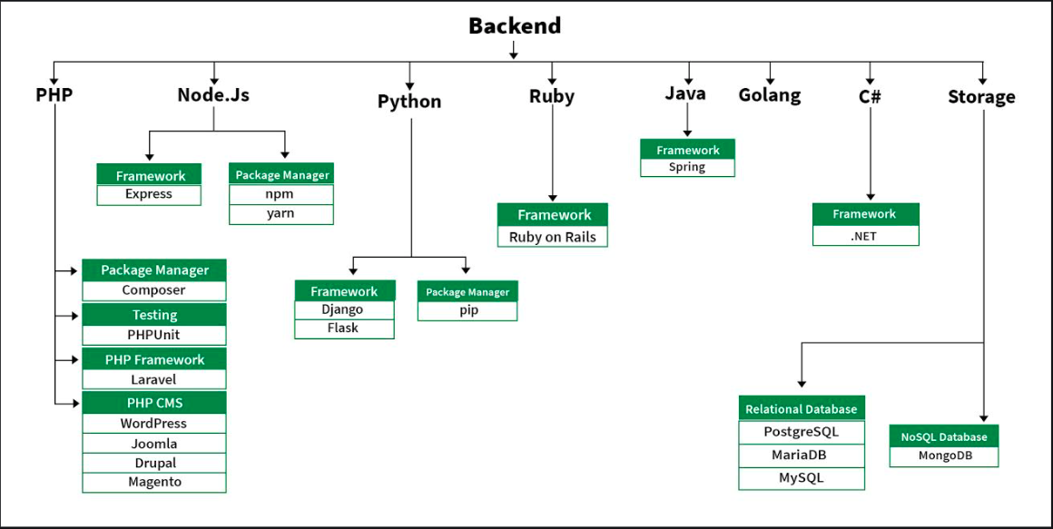
BACK End Development

Slide 14
Full Stack Web Development
Full Stack Development refers to the development of both front end(client side) and back end(server side) portions of web application.
Full-stack developers are comfortable working with both the front and back ends.
Full stack web developers have the ability to design complete web application and websites.
They work on the frontend, backend,database and debugging of web application or websites

Slide 15
Database
A database is an organized collection of structured information, or data, typically stored electronically in a computer system.
A database is usually controlled by a database management system (DBMS).
Database is the collection of interrelated data which helps to inserting and deleting the data from database and organizes the data in the form of tables,views,schemas,reports etc.
EG of database:
Oracle
MogoDB
Sql

Slide 16
Crud Application
CRUD is an acronym that comes from the world of computer programming and refers to the four functions that are considered necessary to implement a persistent storage application:
create
read
update
delete.

Slide 17
Crud Application
In such apps, users must be able to create data, have access to the data in the UI by reading the data, update or edit the data, and delete the data.
In full-fledged applications, CRUD apps consist of 3 parts: an API (or server), a database, and a user interface (UI).
The API (Application Programming Interface)contains the code and methods, the database stores and helps the user retrieve the information, while the user interface helps users interact with the app.
You can make a CRUD app with any of the programming languages out there. And the app doesn’t have to be full stack – you can make a CRUD app with client-side JavaScript.

Slide 18
Tools Used for Coding
Visual Studio
Notepad++
Sublime Text.
UltraEdit.
Atom.

Slide 19
HTML
HTML stands for Hyper Text Markup Language.
HTML is the standard markup language for creating Web pages
HTML describes the structure of a Web page
HTML consists of a series of elements
HTML elements tell the browser how to display the content
HTML elements label pieces of content such as "this is a heading", "this is a paragraph", "this is a link", etc.

Slide 20
CSS
CSS stands for Cascading Style Sheets.
CSS is the language we use to style an HTML document.
CSS describes how HTML elements should be displayed.
CSS can be added to HTML documents in 3 ways:
Inline - by using the style attribute inside HTML elements.
Internal - by using a <style> element in the <head> section.
External - by using a <link> element to link to an external CSS file.

Slide 21
JavaScript
JavaScript was initially created to “make web pages alive”.
The programs in this language are called scripts. They can be written right in a web page’s HTML and run automatically as the page loads.
Scripts are provided and executed as plain text. They don’t need special preparation or compilation to run.
In this aspect, JavaScript is very different from another language called Java.
Today, JavaScript can execute not only in the browser, but also on the server, or actually on any device that has a special program called the JavaScript engine.
The browser has an embedded engine sometimes called a “JavaScript virtual machine”.

Slide 22
Framework
A framework is like a platform used to develop software applications
A framework can have pre defined classes and functions that can be reused to add several functionalities, which otherwise we would have to write on our own. eg http requests .

Slide 23
PHP
PHP is an acronym for "PHP: Hypertext Preprocessor"
PHP is a widely-used, open source scripting language
PHP files can contain text, HTML, CSS, JavaScript, and PHP code
PHP code is executed on the server, and the result is returned to the browser as plain HTML
PHP files have extension ".php"
PHP can generate dynamic page content and PHP scripts are executed on the server
PHP can create, open, read, write, delete, and close files on the server and can collect form data
PHP can send and receive cookies & can add, delete, modify data in your database , control user-access ,encrypt data
PHP runs on various platforms (Windows, Linux, Unix, Mac OS X, etc.)
PHP is compatible with almost all servers used today (Apache, IIS, etc.)
PHP supports a wide range of databases
PHP is free. Download it from the official PHP resource: www.php.net
PHP is easy to learn and runs efficiently on the server side

Slide 24
Single Page Application(SPA)
A single page application is a website or web application that dynamically rewrites a current web page with new data from the web server, instead of the default method of a web browser loading entire new pages.
You'll easily recognize some popular examples of single page applications like Gmail, Google Maps, Airbnb, Netflix, Pinterest, Paypal, and many more. Companies all over the internet are using SPAs to build a fluid, scalable experience.
There is only one html page that is loaded in the browser , when we navigate around the application , the contect changes and not the page .
This therefore allows users to use websites without loading whole new pages from the server, which can result in performance gains and a more dynamic experience
Popular SPA Frameworks: React ,Angular etc.

Slide 25
Responsive Web Design
Responsive Web design is the approach that suggests that design and development should respond to the user’s behavior and environment based on screen size, platform and orientation.
Elements of responsive web design:
Media queries that alter web designs based on a user’s device
Flexible images are sometimes called adaptive images because they have no fixed display size limitations. This versatility makes it easier to resize images neatly.
Fluid grids/fluid layouts that automatically rearrange columns of content to fit different screens or browser windows
Code for flexible layouts that resize page elements to fit different screens or browser windows
HTML (hypertext markup language) is a programming language that determines the content and structure of a webpage,
CSS (cascading style sheets) is a programming language that determines the design and display of HTML elements.

Slide 26
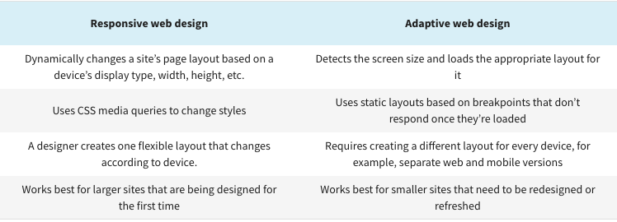
Responsive vs. Adaptive design

Slide 27
Mobile First Development
Mobile-first design or Mobile-first approach enables web designers to start product design for mobile devices first. This can be done by sketching or prototyping the web app’s design for the smallest screen first and gradually working up to larger screen sizes.
Prioritizing design for mobiles makes sense as there are space limitations in devices with smaller screen sizes, and teams need to ensure that the key elements of the website are prominently displayed for anyone using those screens.
Designing and developing for small screens compels designers to remove anything that isn’t necessary for seamless website rendering and navigation.

Slide 28
Mobile First Development
With a well-functioning mobile product, you’ve already prioritized features and capabilities and identified the essential elements of your platform.
Progressively enhancing the mobile platform to fit the requirements for desktop becomes a series of decisions on how to add rather than cut elements of your platform, which gives you another opportunity to be creative about how to engage users.

Slide 29
Job-Roles and Skillset for full stack
A Full Stack Developer is a professional who is capable of working on both the front-end and back-end of web applications.
Full-stack technology refers to the entire depth of a computer system application, and full stack web developers are those who are capable of developing both the front end and the back end of web development.
All of the features that are visible to the client, or the viewer of the site, are included in the front end.
Programming a browser (By using JavaScript, jQuery, Angular, or Vue)
Programming a server (By using PHP, ASP, Python, or Node)

Slide 30
Job-Roles and Skillset for UI/UX
A UI UX designer is a professional who identifies new opportunities to create better user experiences.
Aesthetically pleasing branding strategies help them effectively reach more customers. They also ensure that the end-to-end journey with their products or services meets desired outcomes.
UI/UX Designer responsibilities include:
Gathering and evaluating user requirements, in collaboration with product managers and engineers
Illustrating design ideas using storyboards, process flows and sitemaps
Designing graphic user interface elements, like menus, tabs and widgets

